Slide 1
Capstone Project - The Battle of Neighborhoods Greater Sydney Area, NSW
By: Riyaj Basukala

Slide 2
Introduction and Business Problem
Sydney is one of the most liveable cities in the world with breathtaking landscapes, beautiful beaches, iconic landmarks, and vibrant culture with multi-diversity.
This project focusses on Local Government Areas (LGAs) of Greater Sydney in NSW.
Project focusses on characterizing similarities and differences between the areas of study.
The outcome of the project is anticipated to be quite useful to local/state government, town planner, property developer, potential startup business owner or even prospective home buyers.

Slide 3
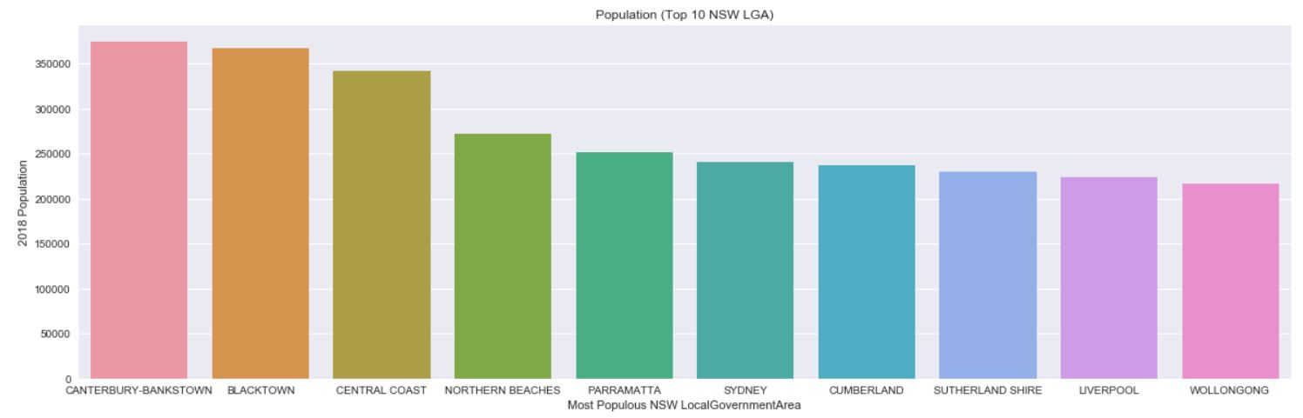
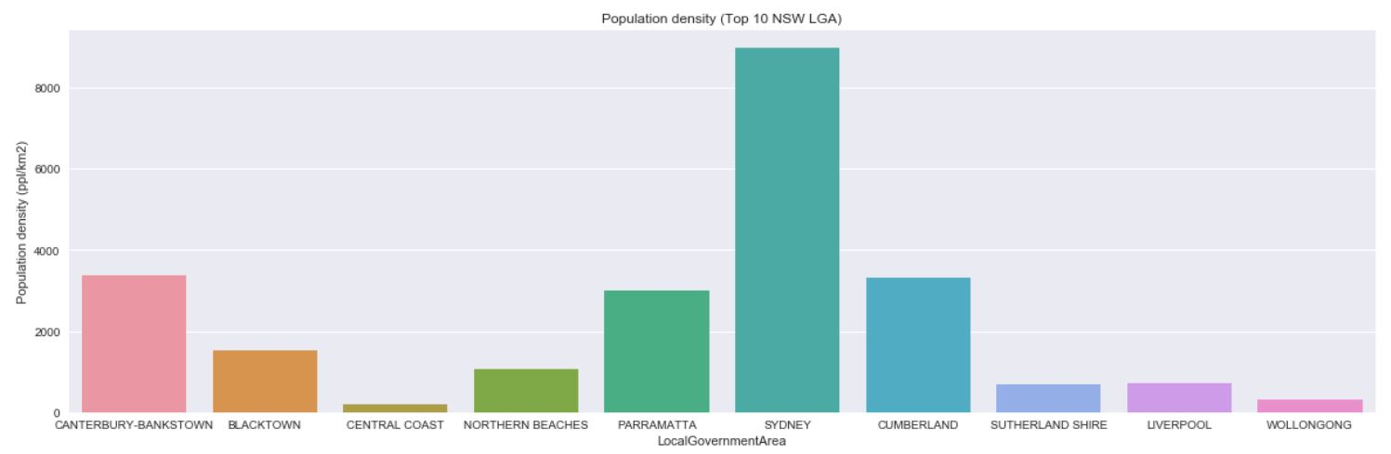
NSW LGA – Selection of LGAs to study
LGAs for this project are selected based on population.
Out of 10 most populous LGAs of Greater Sydney, top 4 with highest density are selected

Slide 4
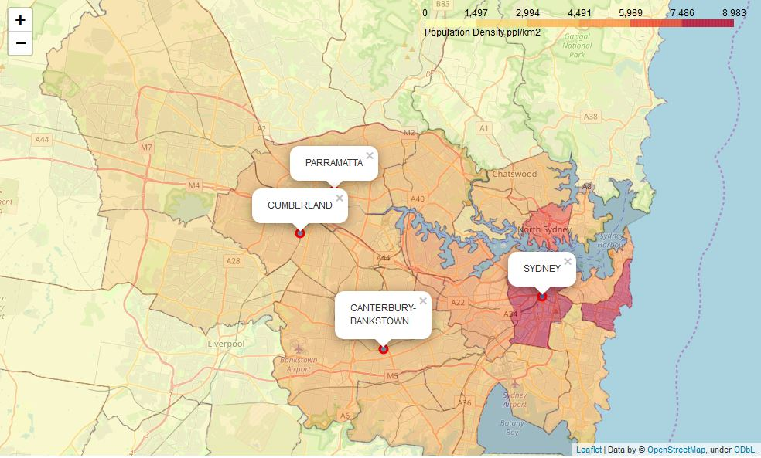
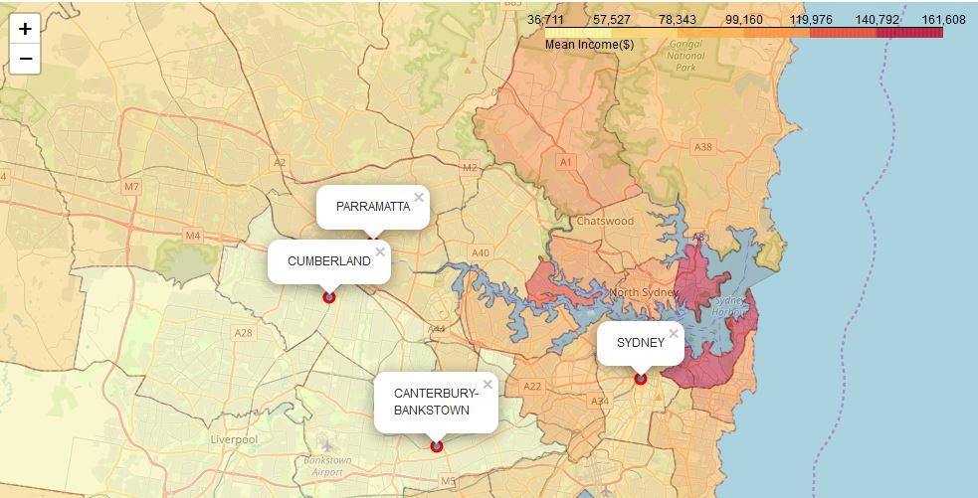
Comparison of 4 LGAs (most populous)
City of Sydney has higher population density and mean income than south western and western counterparts.

Slide 5
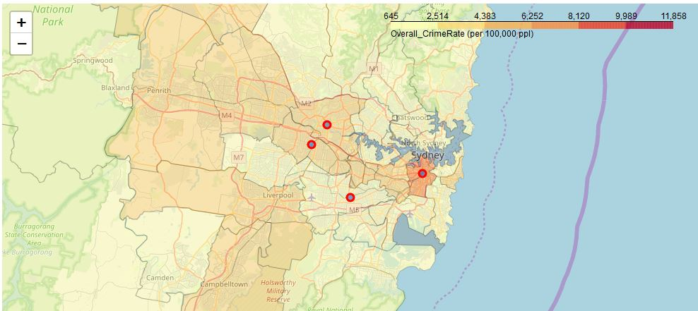
Comparison of 4 LGAs (most populous)
It can be seen that City of Sydney had the highest crime rate among the four LGAs.
Canterbury-Bankstown had the lowest crime rates.

Slide 6
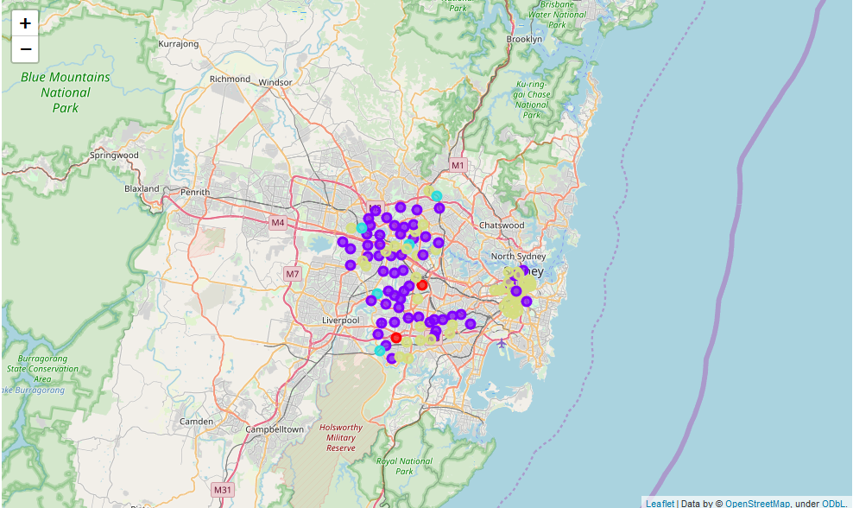
Comparison of 4 LGAs – k means Clustering
Using the partitioning based method of k-means clustering. It was seen that venue categories in the neighborhoods of Parramatta and Cumberland were fairly similar.
City of Sydney mainly had neighborhoods belonging to yellowish-green cluster with mainly café, bar/pub, pizza places.

Slide 7
Conclusion
This project has gone into characterizing four of the most populous areas of Greater Sydney. Income data, crime rate, population density and most common type of venues nearby were used to view the characteristics of those areas.
This project has made use of online available data sources including web data and online location-based service API, foursquare, to gain insights into the neighborhoods of different Local Government Areas in Greater Sydney.
As an enhancement or further works on the project, house sales data can be brought in and cross checked with neighborhood venues in order to examine sale price depending on location.

